Slide 1

Detecting Anomalous Faces with “No Peeking” Autoencoders
Anand Bhattad, Jason Rock, and David Forsyth
University of Illinois at Urbana Champaign

Slide 2
Motivation
Incapacitated Machine Operator
Sleepy/Fatigued Driver
INTRODUCTION
DATASETS
APPROACH
EYEGLASSES
TRUE ANOMALY
ABLATION
CONCLUSION
Notes:
Facial Anomaly Detection has critical applications in detecting incapacitated machine operators (say) a driver,

Slide 3
Motivation
Incapacitated Machine Operator
Sleepy/Fatigued Driver
Monitor patients in ICU
INTRODUCTION
DATASETS
APPROACH
EYEGLASSES
TRUE ANOMALY
ABLATION
CONCLUSION
Notes:
Or Another applications is to monitor patients admitted into an ICU

Slide 4
Anomaly Detection in Literature
One class as inliers and all others as outliers [1]
9 vs 1-8 in MNIST
Dog vs others in CIFAR 10
1. Zhai, Shuangfei, et al. "Deep structured energy based models for anomaly detection." ICML 2016.
INTRODUCTION
DATASETS
APPROACH
EYEGLASSES
TRUE ANOMALY
ABLATION
CONCLUSION
Notes:
There has been quite a lot of work done on Anomaly Detection. In most of these works, we will find that the problem is set up as one of the class from data set as inlier and other as outlier.

Slide 5
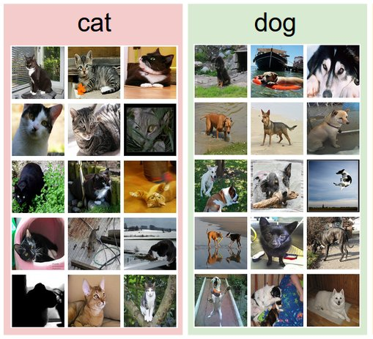
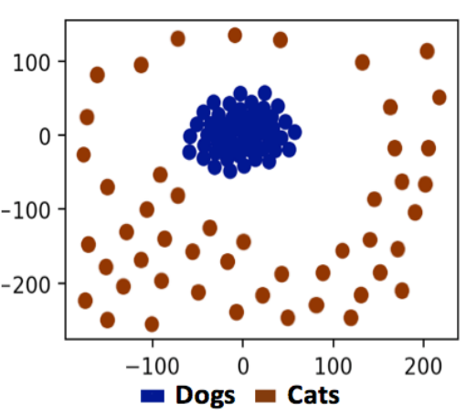
Anomaly Detection in Literature
One class as inliers and all others as outliers
9 vs 1-8 in MNIST
Dog vs others in CIFAR 10
1. Zhai, Shuangfei, et al. "Deep structured energy based models for anomaly detection." ICML 2016.
INTRODUCTION
DATASETS
APPROACH
EYEGLASSES
TRUE ANOMALY
ABLATION
CONCLUSION

Slide 6
Anomaly Detection in Literature
One class as inliers and all others as outliers
9 vs 1-8 in MNIST
Dog vs others in CIFAR 10
Are these True Anomalies?
1. Zhai, Shuangfei, et al. "Deep structured energy based models for anomaly detection." ICML 2016.
INTRODUCTION
DATASETS
APPROACH
EYEGLASSES
TRUE ANOMALY
ABLATION
CONCLUSION

Slide 7
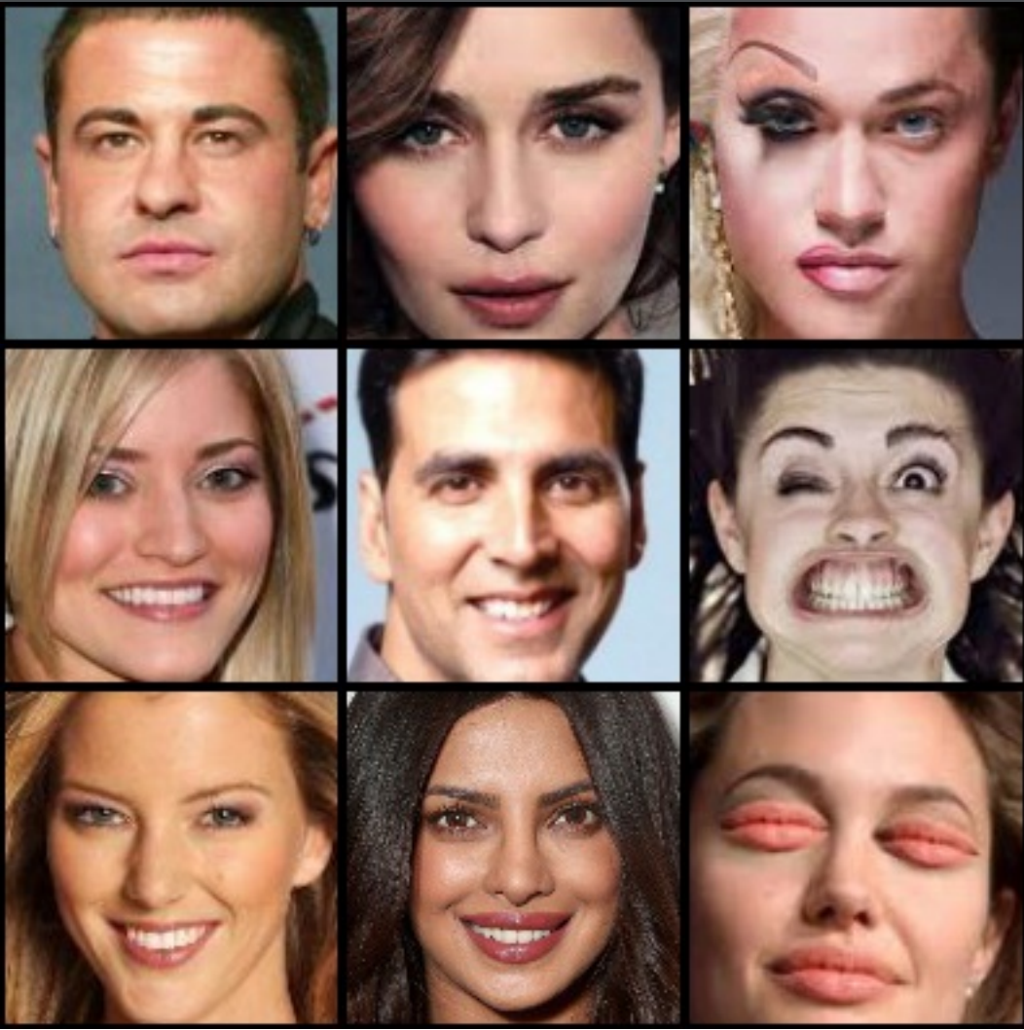
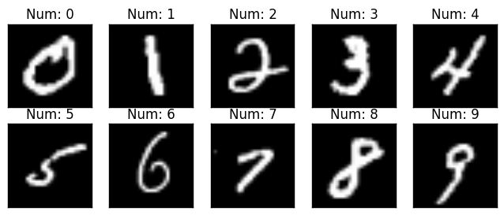
True Anomalies
Rare and not easily available
Vs
INTRODUCTION
DATASETS
APPROACH
EYEGLASSES
TRUE ANOMALY
ABLATION
CONCLUSION

Slide 8
True Anomalies
Rare and not easily available
Small variations in features
Vs
INTRODUCTION
DATASETS
APPROACH
EYEGLASSES
TRUE ANOMALY
ABLATION
CONCLUSION

Slide 9
Challenges
Ideal Dataset
Ideal Detector
Ideal Setup
INTRODUCTION
DATASETS
APPROACH
EYEGLASSES
TRUE ANOMALY
ABLATION
CONCLUSION

Slide 10
Contributions
Novel features based on Inpainting Autoencoders’ Residuals (IRF)
INTRODUCTION
DATASETS
APPROACH
EYEGLASSES
TRUE ANOMALY
ABLATION
CONCLUSION

Slide 11
Contributions
Novel features based on Inpainting Autoencoders’ Residuals (IRF)
Unsupervised setup for Anomaly Detection
INTRODUCTION
DATASETS
APPROACH
EYEGLASSES
TRUE ANOMALY
ABLATION
CONCLUSION

Slide 12
Contributions
Novel features based on Inpainting Autoencoders’ Residuals (IRF)
Unsupervised setup for Anomaly Detection
Propose two datasets
Anomaly Set
Typical Set
INTRODUCTION
DATASETS
APPROACH
EYEGLASSES
TRUE ANOMALY
ABLATION
CONCLUSION

Slide 13
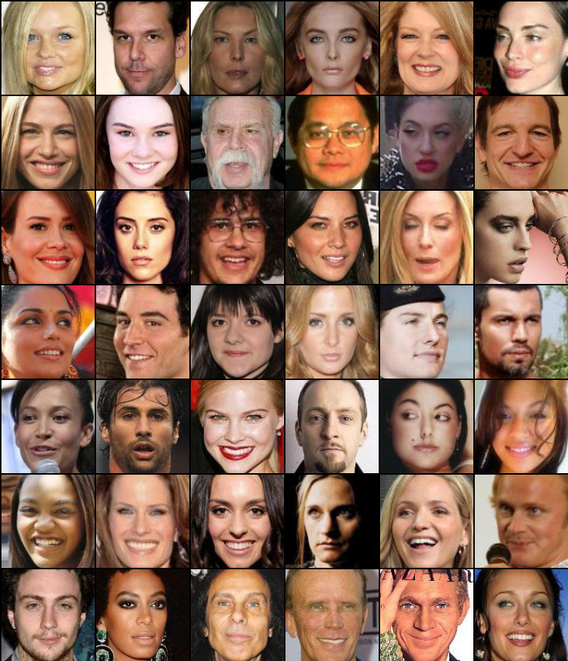
Datasets
celebA
INTRODUCTION
DATASETS
APPROACH
EYEGLASSES
TRUE ANOMALY
ABLATION
CONCLUSION

Slide 14
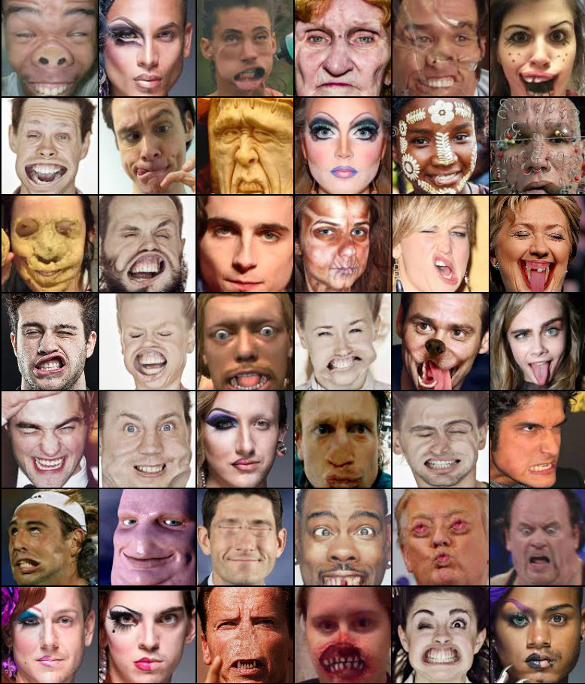
Datasets
celebA
Anomaly
INTRODUCTION
DATASETS
APPROACH
EYEGLASSES
TRUE ANOMALY
ABLATION
CONCLUSION

Slide 15
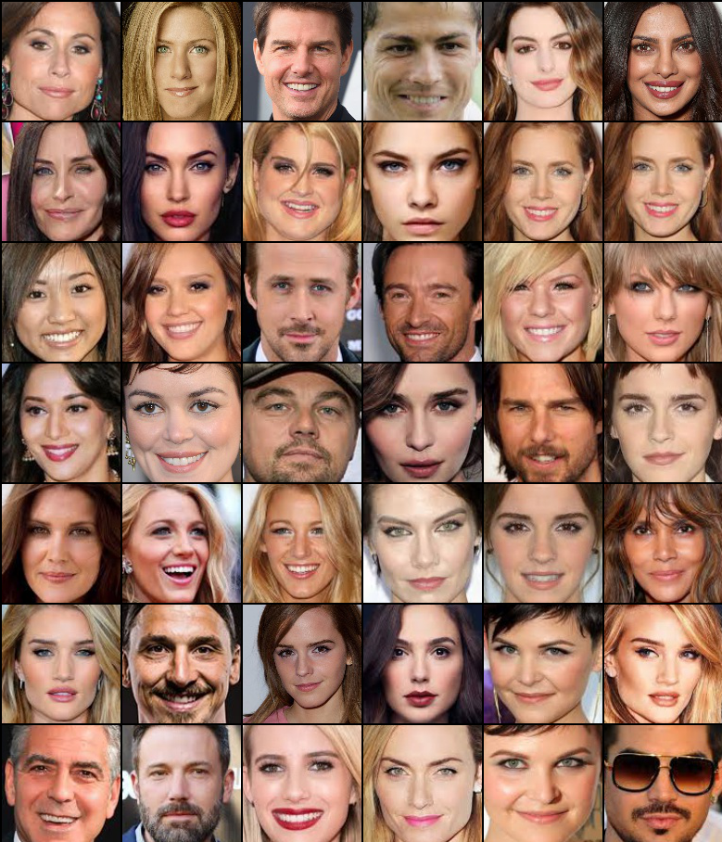
Datasets
celebA
Anomaly
Typical
INTRODUCTION
DATASETS
APPROACH
EYEGLASSES
TRUE ANOMALY
ABLATION
CONCLUSION

Slide 16
Datasets
Anomaly Set - Hand determined - 316 images - is a face (Passes Viola Jones)
INTRODUCTION
DATASETS
APPROACH
EYEGLASSES
TRUE ANOMALY
ABLATION
CONCLUSION

Slide 17
Datasets
Anomaly Set - Hand determined - 316 images - is a face (Passes Viola Jones)
Typical Set - No celebA images - 100 images - is a face (Passes Viola Jones)
INTRODUCTION
DATASETS
APPROACH
EYEGLASSES
TRUE ANOMALY
ABLATION
CONCLUSION

Slide 18
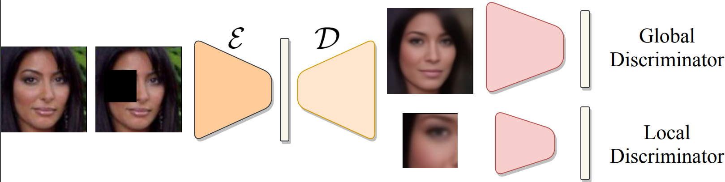
Previous Methods
Autoencoder Codes
Autoencoder Residuals
INTRODUCTION
DATASET
APPROACH
EYEGLASSES
TRUE ANOMALY
ABLATION
CONCLUSION

Slide 19
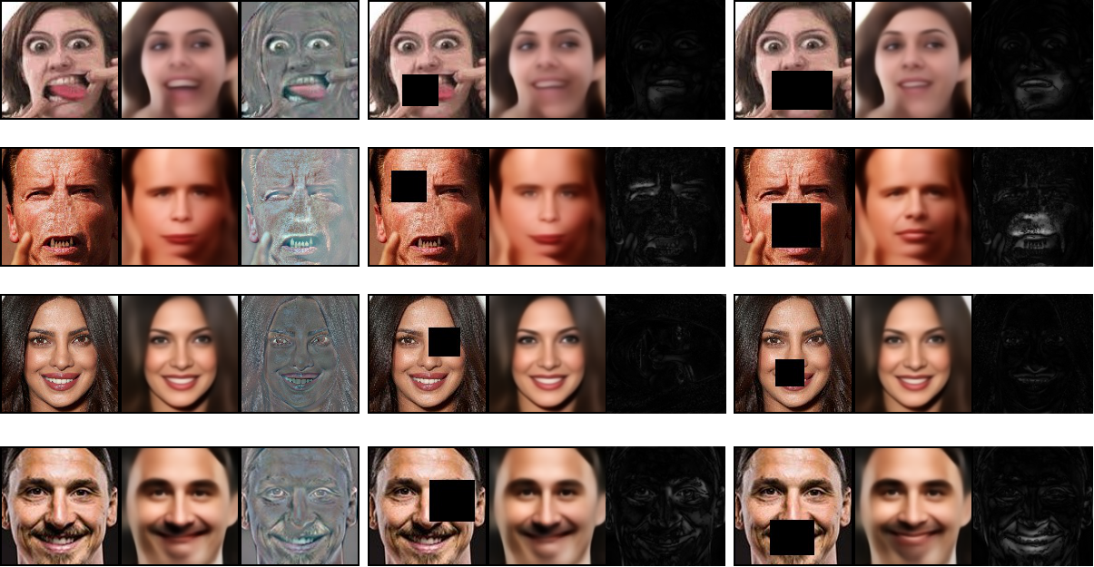
Previous Methods
I
O
R=I-O
Anomaly Set
Typical Set
INTRODUCTION
DATASET
APPROACH
EYEGLASSES
TRUE ANOMALY
ABLATION
CONCLUSION

Slide 20
Previous Methods
I
O
R=I-O
“Peeking”- Reconstructions based on neighboring pixels
Low mean losses
Anomaly Set
Typical Set
INTRODUCTION
DATASET
APPROACH
EYEGLASSES
TRUE ANOMALY
ABLATION
CONCLUSION

Slide 21
Beating Peeking with Inpainting Autoencoder
I
O
R=I-O
I
O
R’’=R’-R
Anomaly Set
Typical Set
INTRODUCTION
DATASET
APPROACH
EYEGLASSES
TRUE ANOMALY
ABLATION
CONCLUSION

Slide 22
Beating Peeking with Inpainting Autoencoder
I
O
R=I-O
I
O
R’’=R’-R
I
O
R’’=R’-R
Anomaly Set
Typical Set
INTRODUCTION
DATASET
APPROACH
EYEGLASSES
TRUE ANOMALY
ABLATION
CONCLUSION

Slide 23
Training
Random Boxes
L1 Loss
INTRODUCTION
DATASET
APPROACH
EYEGLASSES
TRUE ANOMALY
ABLATION
CONCLUSION

Slide 24
Training
Random Boxes
L1 Loss
Adversarial Losses
INTRODUCTION
DATASET
APPROACH
EYEGLASSES
TRUE ANOMALY
ABLATION
CONCLUSION

Slide 25
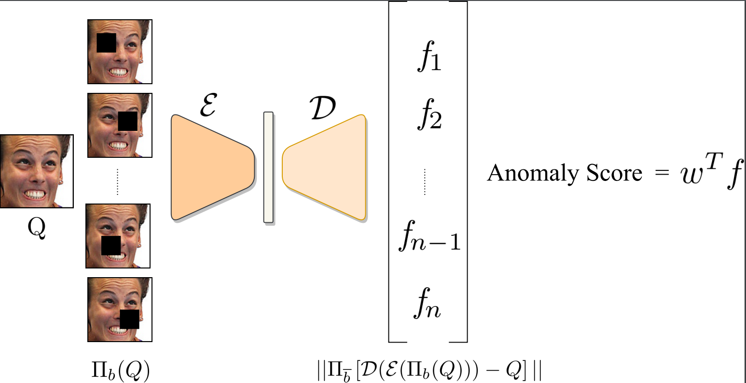
Testing
INTRODUCTION
DATASET
APPROACH
EYEGLASSES
TRUE ANOMALY
ABLATION
CONCLUSION

Slide 26
Testing
INTRODUCTION
DATASET
APPROACH
EYEGLASSES
TRUE ANOMALY
ABLATION
CONCLUSION

Slide 27
Testing
32x32 grid boxes
Rank images based on these scores
INTRODUCTION
DATASET
APPROACH
EYEGLASSES
TRUE ANOMALY
ABLATION
CONCLUSION

Slide 28
Testing
Mean
ocSVM
Mahalanobis Distance
L-inf
Local False Discovery Rate
Prior weighting
INTRODUCTION
DATASET
APPROACH
EYEGLASSES
TRUE ANOMALY
ABLATION
CONCLUSION

Slide 29
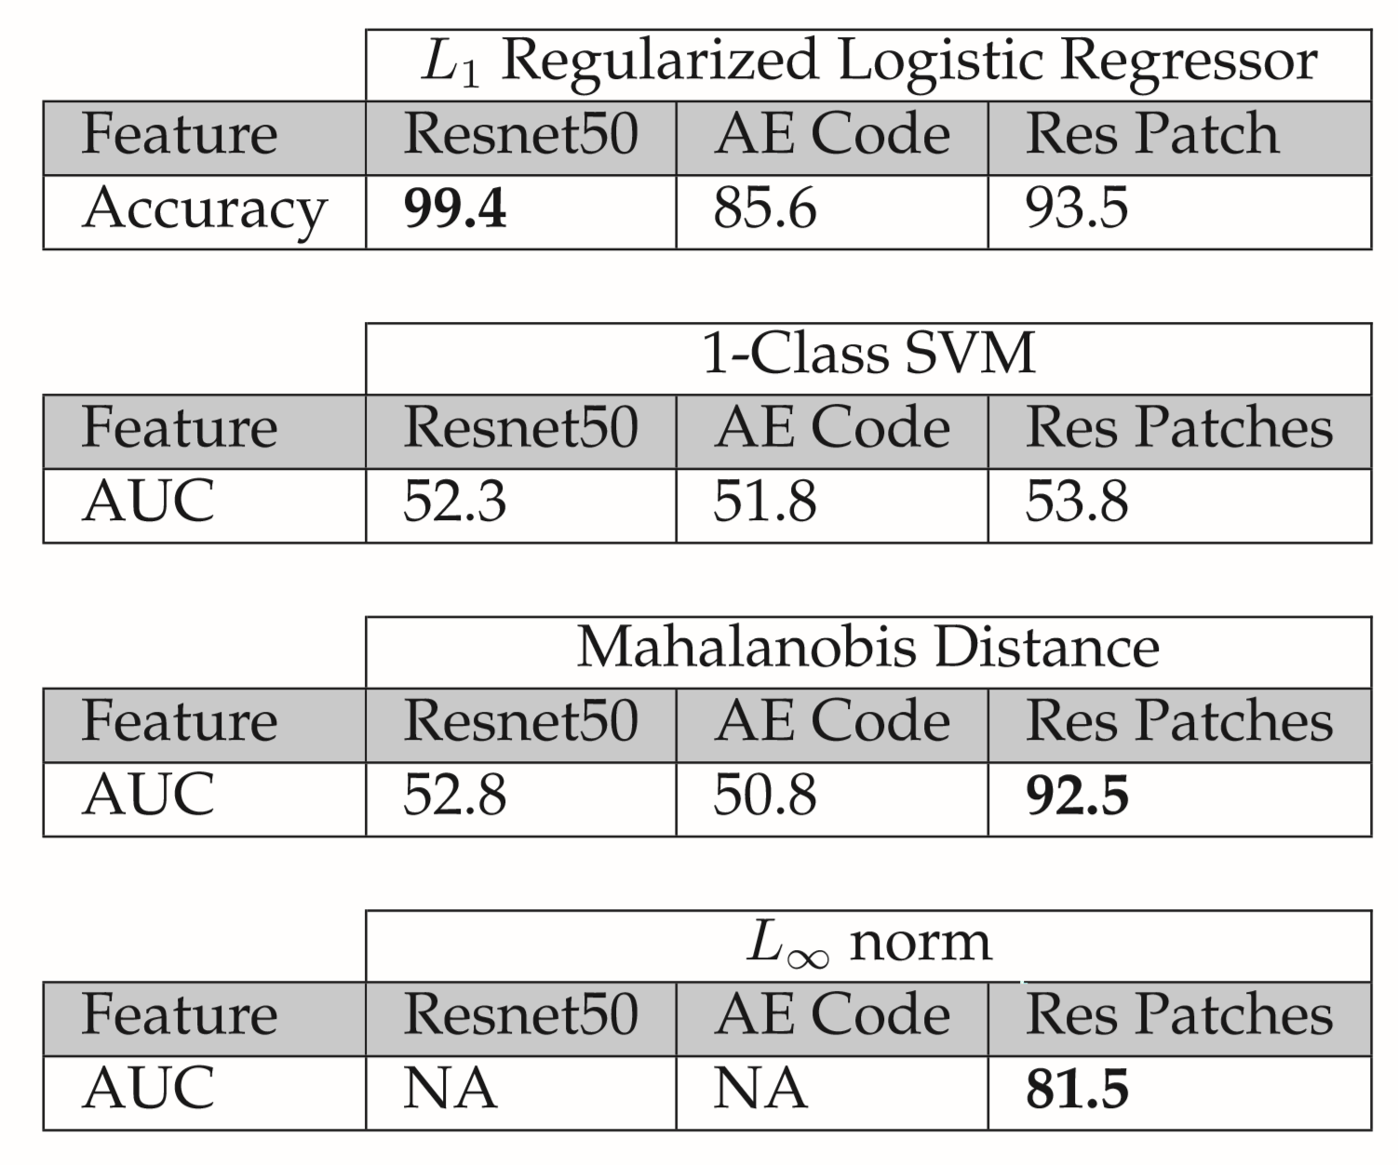
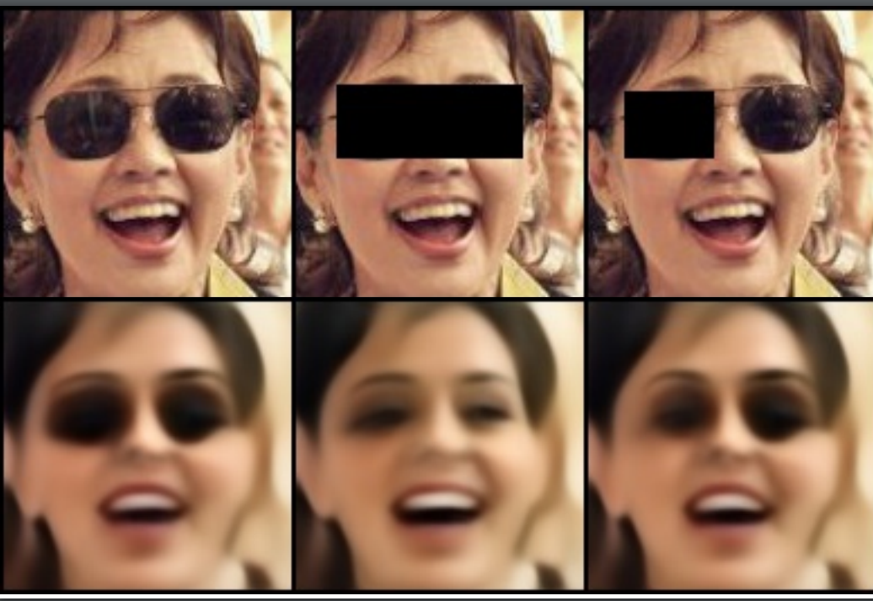
Eyeglasses Experiment
INTRODUCTION
DATASET
APPROACH
EYEGLASSES
TRUE ANOMALY
ABLATION
CONCLUSION

Slide 30
Eyeglasses Experiment
INTRODUCTION
DATASET
APPROACH
EYEGLASSES
TRUE ANOMALY
ABLATION
CONCLUSION

Slide 31
Eyeglasses Experiment
INTRODUCTION
DATASET
APPROACH
EYEGLASSES
TRUE ANOMALY
ABLATION
CONCLUSION

Slide 32
Eyeglasses Experiment
INTRODUCTION
DATASET
APPROACH
EYEGLASSES
TRUE ANOMALY
ABLATION
CONCLUSION

Slide 33
True Anomaly Experiments
Analogous approach to Deep Sets [2]
2. Zaheer, Manzil, et al. "Deep sets." NIPS 2017.
INTRODUCTION
DATASET
APPROACH
EYEGLASSES
TRUE ANOMALY
ABLATION
CONCLUSION
Notes:
Scarcity of True Anomaly data, we evaluate our method
For recalls, higher the better and For Mean rank lower the better

Slide 34
True Anomaly Experiments
Analogous approach to Deep Sets [2]
One anomaly shuffled with n-1 non anomalous images
2. Zaheer, Manzil, et al. "Deep sets." NIPS 2017.
INTRODUCTION
DATASET
APPROACH
EYEGLASSES
TRUE ANOMALY
ABLATION
CONCLUSION
Notes:
Scarcity of True Anomaly data, we evaluate our method
For recalls, higher the better and For Mean rank lower the better

Slide 35
True Anomaly Experiments
Analogous approach to Deep Sets [2]
One anomaly shuffled with n-1 non anomalous images
Recall@1, Recall@5, Recall@10, and Mean Rank
2. Zaheer, Manzil, et al. "Deep sets." NIPS 2017.
INTRODUCTION
DATASET
APPROACH
EYEGLASSES
TRUE ANOMALY
ABLATION
CONCLUSION
Notes:
Scarcity of True Anomaly data, we evaluate our method
For recalls, higher the better and For Mean rank lower the better

Slide 36
True Anomaly Experiments
Analogous approach to Deep Sets [2]
One anomaly shuffled with n-1 non anomalous images
Recall@1, Recall@5, Recall@10, and Mean Rank
Set size n=16 to n=300
2. Zaheer, Manzil, et al. "Deep sets." NIPS 2017.
INTRODUCTION
DATASET
APPROACH
EYEGLASSES
TRUE ANOMALY
ABLATION
CONCLUSION
Notes:
Scarcity of True Anomaly data, we evaluate our method
For recalls, higher the better and For Mean rank lower the better

Slide 37
True Anomaly Experiments
INTRODUCTION
DATASET
APPROACH
EYEGLASSES
TRUE ANOMALY
ABLATION
CONCLUSION
Notes:
GANs doesn’t work for this task
Resnet 50 is not completely unsupervised, since we are using a pretrained resnet which was trained on entire celebA for Facial Recognition

Slide 38
True Anomaly Experiments
INTRODUCTION
DATASET
APPROACH
EYEGLASSES
TRUE ANOMALY
ABLATION
CONCLUSION

Slide 39
True Anomaly Experiments
INTRODUCTION
DATASET
APPROACH
EYEGLASSES
TRUE ANOMALY
ABLATION
CONCLUSION

Slide 40
True Anomaly Experiments
INTRODUCTION
DATASET
APPROACH
EYEGLASSES
TRUE ANOMALY
ABLATION
CONCLUSION

Slide 41
True Anomaly Experiment
BEGAN
AE Residuals
Resnet50(Mahal)
INTRODUCTION
DATASET
APPROACH
EYEGLASSES
TRUE ANOMALY
ABLATION
CONCLUSION

Slide 42
True Anomaly Experiment
BEGAN
AE Residuals
ocSVM(IRF)
Resnet50(Mahal)
Mean(IRF)
Weighted(IRF)
INTRODUCTION
DATASET
APPROACH
EYEGLASSES
TRUE ANOMALY
ABLATION
CONCLUSION

Slide 43
True Anomaly Experiment
BEGAN
AE Residuals
ocSVM(IRF)
Resnet50(Mahal)
Mean(IRF)
Weighted(IRF)
INTRODUCTION
DATASET
APPROACH
EYEGLASSES
TRUE ANOMALY
ABLATION
CONCLUSION

Slide 44
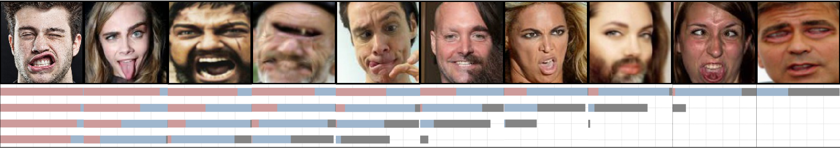
Qualitative Results
Anomaly Set: Median Image from each decile
INTRODUCTION
DATASET
APPROACH
EYEGLASSES
TRUE ANOMALY
ABLATION
CONCLUSION

Slide 45
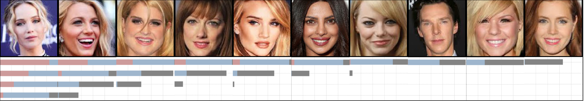
Qualitative Results
Anomaly Set: Median Image from each decile
Typical Set: Median Image from each decile
INTRODUCTION
DATASET
APPROACH
EYEGLASSES
TRUE ANOMALY
ABLATION
CONCLUSION

Slide 46
Model Variants
INTRODUCTION
DATASET
APPROACH
EYEGLASSES
TRUE ANOMALY
ABLATION
CONCLUSION

Slide 47
Model Variants
INTRODUCTION
DATASET
APPROACH
EYEGLASSES
TRUE ANOMALY
ABLATION
CONCLUSION

Slide 48
Easy vs Hard Set
INTRODUCTION
DATASET
APPROACH
EYEGLASSES
TRUE ANOMALY
ABLATION
CONCLUSION

Slide 49
Easy vs Hard Set
INTRODUCTION
DATASET
APPROACH
EYEGLASSES
TRUE ANOMALY
ABLATION
CONCLUSION

Slide 50
Conclusions
Unsupervised framework for evaluating future anomaly detection, enabled through two small datasets
INTRODUCTION
DATASET
APPROACH
EYEGLASSES
TRUE ANOMALY
ABLATION
CONCLUSION

Slide 51
Conclusions
Unsupervised framework for evaluating future anomaly detection, enabled through two small datasets
IRF combats the over-generalization of compression losses
INTRODUCTION
DATASET
APPROACH
EYEGLASSES
TRUE ANOMALY
ABLATION
CONCLUSION

Slide 52
Conclusions
Unsupervised framework for evaluating future anomaly detection, enabled through two small datasets
IRF combats the over-generalization of compression losses
IRF works well for both supervised and unsupervised task
INTRODUCTION
DATASET
APPROACH
EYEGLASSES
TRUE ANOMALY
ABLATION
CONCLUSION

Slide 53
Limitations
Good performance for concentrated anomalies compared to diffused anomalies
INTRODUCTION
DATASET
APPROACH
EYEGLASSES
TRUE ANOMALY
ABLATION
CONCLUSION

Slide 54
Limitations
Good performance for concentrated anomalies compared to diffused anomalies
Solution: Multiple boxes instead of just one
INTRODUCTION
DATASET
APPROACH
EYEGLASSES
TRUE ANOMALY
ABLATION
CONCLUSION

Slide 55
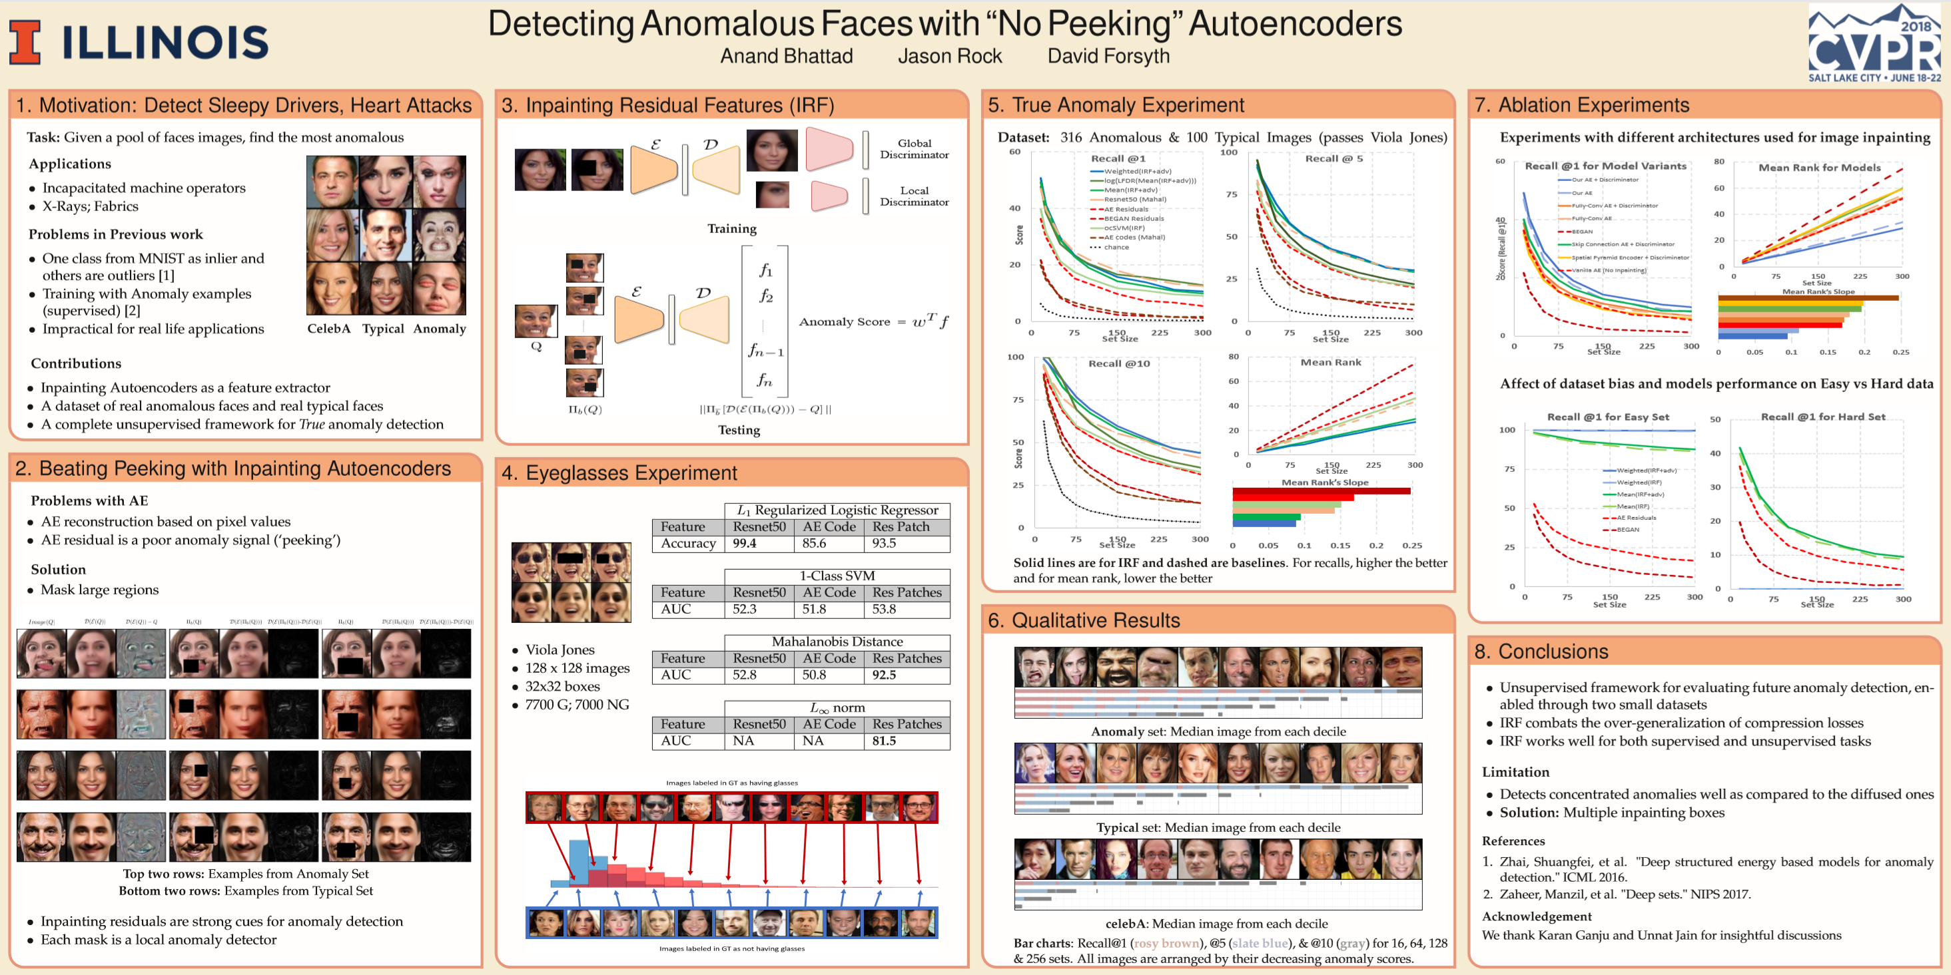
Poster #125
INTRODUCTION
DATASET
APPROACH
EYEGLASSES
TRUE ANOMALY
ABLATION
CONCLUSION

